Slide 1
Civil War Battles and Virginia Generals
By Miss Oberlander

Slide 2
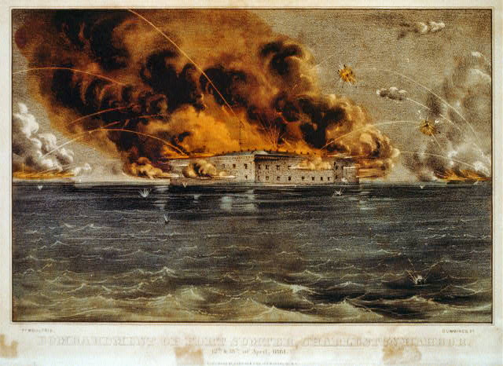
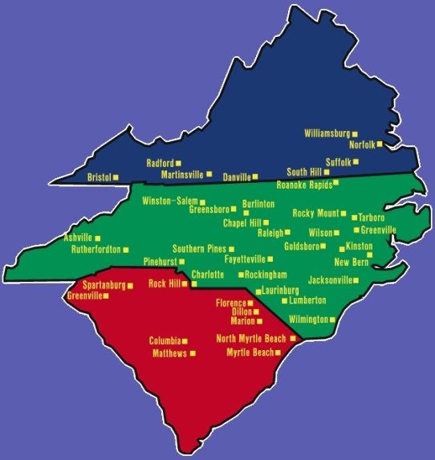
Fort Sumter The Civil War began in April 1861 when Confederate forces fired shots at the Union fort—Fort Sumter in South Carolina.
Confederates won.

Slide 3
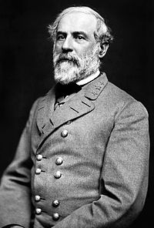
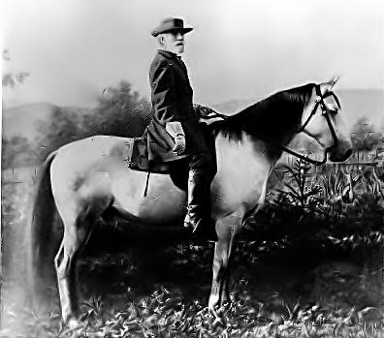
Robert E. Lee
Virginian
Commanded the Confederate Army of Northern Virginia during the American Civil War.

Slide 4
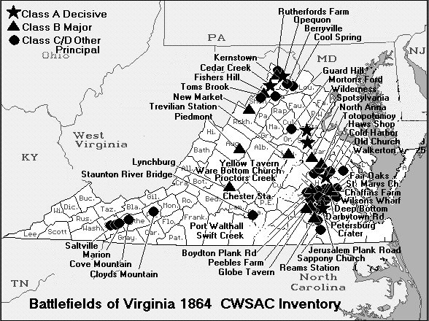
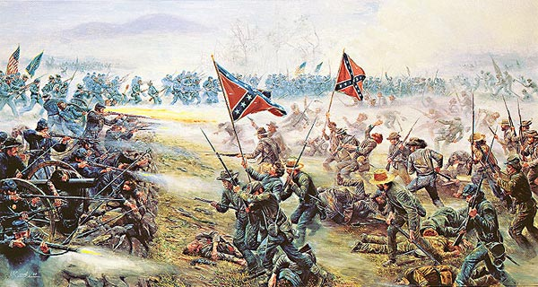
Battles in Virginia
Because the Union wanted to capture the South’s capital, Richmond, VA and the Confederates wanted to capture the North’s capital, Washington, D.C.

Slide 5
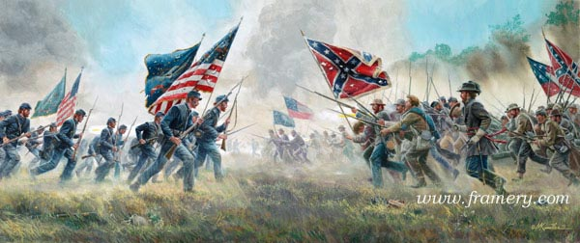
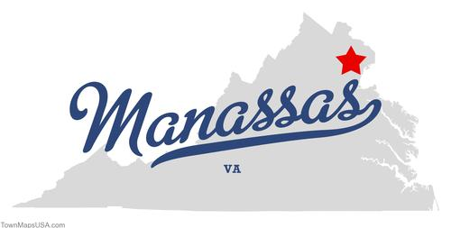
Battle of Manassas July 1861: The first Battle of Bull Run (or Manassas) was the first major clash of the Civil War.
Confederates won.

Slide 6
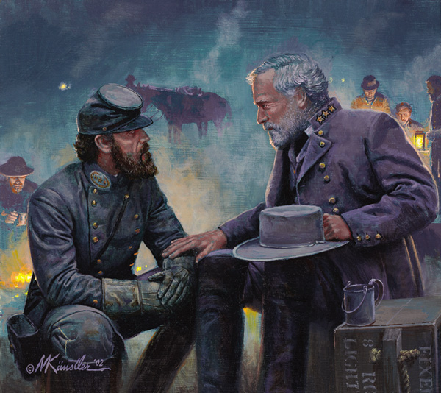
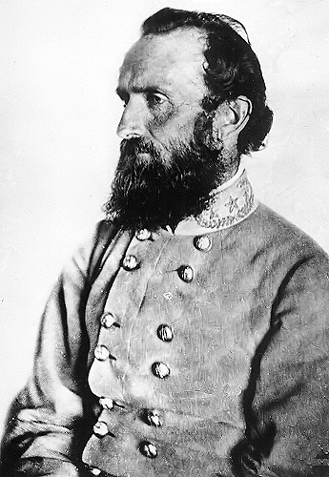
Stonewall Jackson
Considered Robert E. Lee’s
“right hand man”
.—"Stonewall" Jackson won his nickname during the Battle of Manassas. He held his ground with his troops.
"Look at Jackson standing there like a stone wall,” General Bee who uttered these words, just before he fell, adding, "Rally on the Virginians."

Slide 7
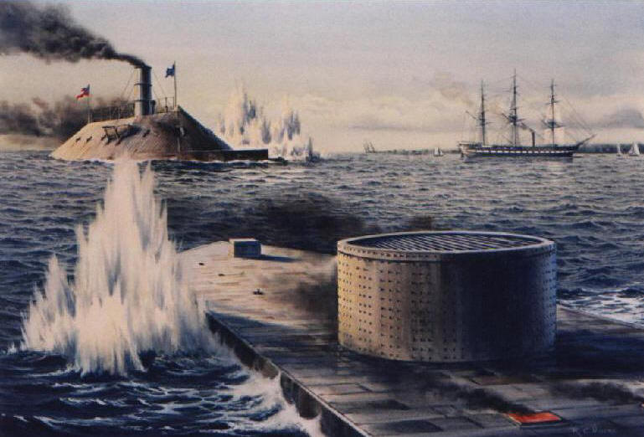
Battle of the Monitor and the Merrimack
Lincoln used the Union navy to blockade southern ports. An important sea battle between the Monitor (Union) and the Merrimack (Confederate), two iron-clad ships, took place in Virginia waters near Norfolk and Hampton, VA. The battle was fought to a draw.
http://www.youtube.com/watch?v=vmnnqJm_4Pc&safety_mode=true&persist_safety_mode=1&safe=active

Slide 8
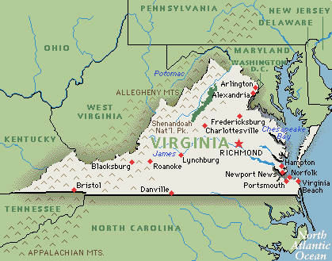
Battle of the Ironclads
Took place in the harbor by Norfolk, VA

Slide 9
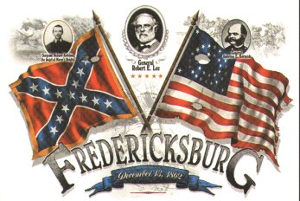
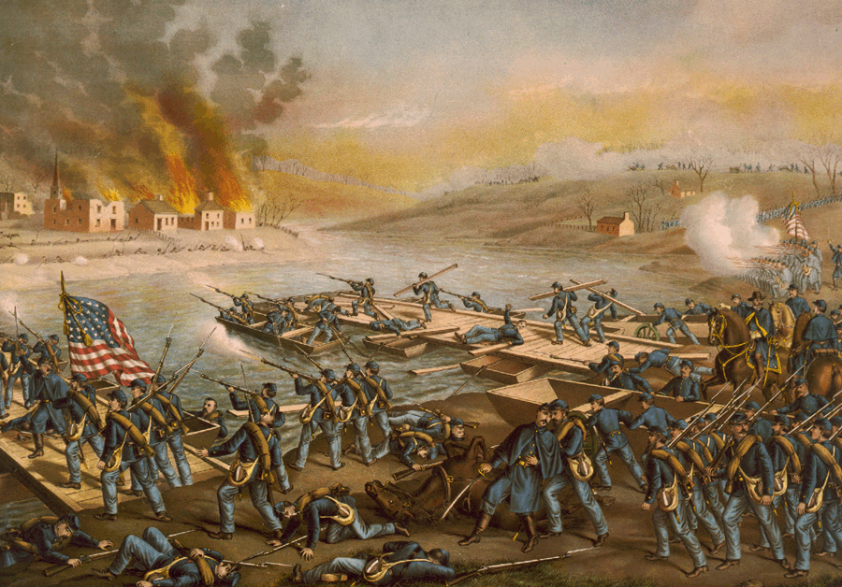
Battle of Fredericksburg General Robert E. Lee, Commander of the Army of Northern Virginia, defeated Union troops at Fredericksburg, Virginia 1862.
Confederates won.

Slide 10
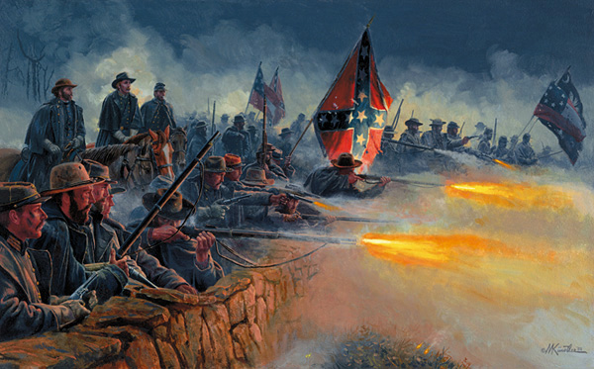
Battle of Fredericksburg, Dec. 1862: Robert E. Lee (South) vs. General Burnside (North). Burnside was trying to cross the Rappahannock River and get closer to capturing Richmond. Confederates won this battle. Union lost twice as many men as the Confederates.

Slide 11
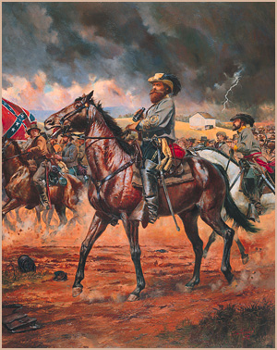
J.E.B. Stuart
James Ewell Brown "Jeb" Stuart
US Army officer from Virginia and a Confederate States Army general during the American Civil War.
Calvary commander (rode horses)
Scout for reconnaissance (spy) missions
“eyes and ears of the Confederate Army” (Lee)
Important part of winning the Battle of Fredericksburg

Slide 12
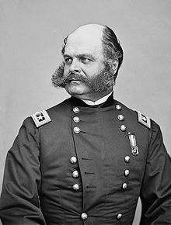
General Burnside (Union)
Northern general
Defeated by Confederates at Fredericksburg
The word “side burns” comes from his name, because of his distinctive facial hair.

Slide 13
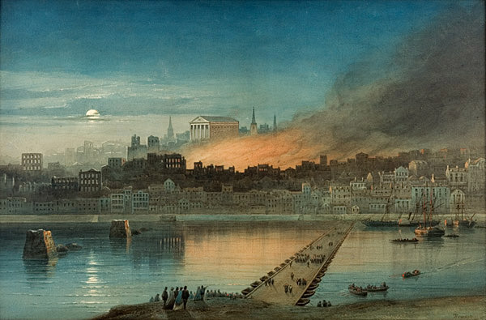
Burning of Richmond capital of the Confederacy. It fell to Northern General Ulysses S. Grant and was burned near the end of the war.
Union won.

Slide 14
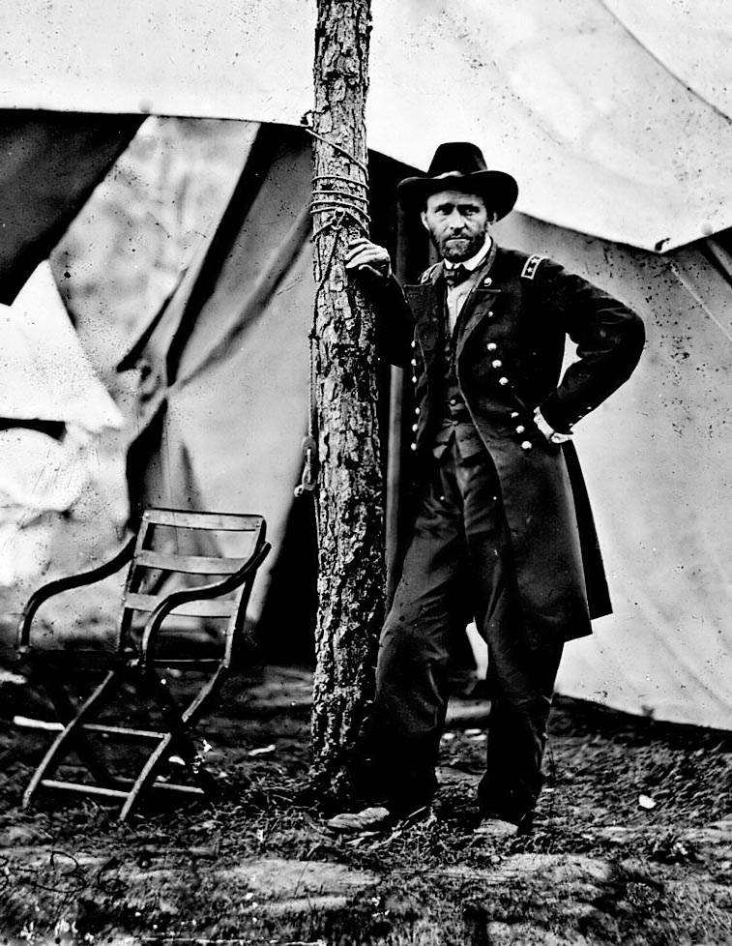
Ulysses S. Grant (Union)
Northern General
Had many victories in western battles
Later becomes the president of the United States
Burned Richmond to make the Confederates give up
Lee surrenders to Grant at Appomattox

Slide 15
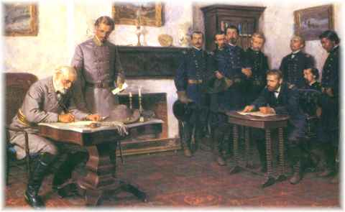
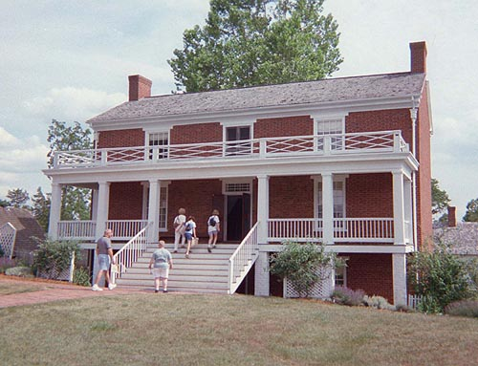
Surrender at Appomattox (Virginia) The Civil War ended at Appomattox Court House, Virginia, where Confederate General Robert E. Lee surrendered his army to Union General Ulysses S. Grant in April 1865.

Slide 16
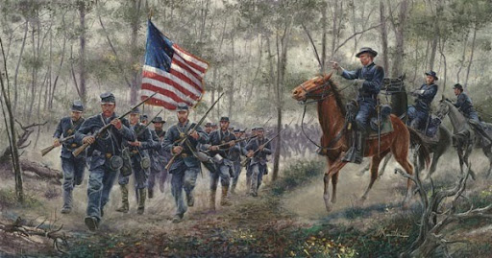
Quiz Time to Review!

Slide 17
Where was the first “shot” fired to start the Civil War?
A. Manassas, Virginia
B. Fort Sumter, South Carolina
C. Fredericksburg, Virginia

Slide 18
What year did the Civil War begin?
A. 1865
B. 1862
C. 1861

Slide 19
Who Commanded the Army of Northern Virginia during the American Civil War?
A. Ulysses. S. Grant
B. Robert E. Lee
C. General Burnside

Slide 20
Where was the Union capital?
A. Richmond, Virginia
B. Montgomery, Alabama
C. Washington, D.C.

Slide 21
Where was the Confederate capital for most of the war?
A. Richmond, Virginia
B. Washington, D.C.
C. Montgomery, Alabama

Slide 22
Why was Virginia the state with so many Civil War battles?
A. Because the North’s capital and the South’s capital were located in or near Virginia
B. Because Virginia was the first state to secede from the Union
C. Because Robert E. Lee’s home was in Virginia

Slide 23
What was the first major clash of the Civil War?
A. The Battle of Bull Run
B. The Battle of Gettysburg
C. The Battle of Fredericksburg

Slide 24
What is another name for the Battle of Bull Run?
A. Battle of Manassas
B. Battle of Fredericksburg
C. Battle of Richmond

Slide 25
Which side won the Battle of Bull Run?
A. North
B. Confederate
C. Union

Slide 26
Who was considered Robert E. Lee’s “right hand man”?
A. Stuart
B. Jackson
C. Burnside

Slide 27
What is the term that means the patrolling of waters around port cities?
A. Surrender
B. Blockade
C. Ironclad

Slide 28
Who was the commander of the Army of Northern Virginia?
A. Jackson
B. Grant
C. Lee

Slide 29
Who won his nickname during the Battle of Manassas, because he held his ground with his troops?
A. Grant
B. Stuart
C. Jackson

Slide 30
What were the Monitor and the Merrimack?
A. Ships
B. Battles
C. Ironclads

Slide 31
What side was the Monitor on?
A. North
B. South
C. Confederates

Slide 32
What side was the Merrimack on?
A. North
B. South
C. American

Slide 33
Who won the Battle of the Ironclads?
A. Monitor
B. Merrimack
C. Neither

Slide 34
What does it mean to fight to a “draw”?
A. Lose
B. Tie
C. Win

Slide 35
Where did the Battle of the Ironclads take place?
The harbor outside of Richmond, VA
The harbor outside of Norfolk, VA
On land around Fredericksburg

Slide 36
What important VA battle was fought in 1862 where Lee defeated Burnside?
A. Battle of Richmond
B. Battle of Manassas
C. Battle of Fredericksburg

Slide 37
What side did General Burnside fight for?
A. Confederates
B. Union
C. British

Slide 38
Who was the Confederate cavalry officer, who scouted out on spy missions and played an important role in the defeat of the Union at Fredericksburg?
A. Stonewall Jackson
B. Ulysses S. Grant
C. J.E.B. Stuart

Slide 39
What does reconnaissance mean?
A. Necessary
B. Deadly
C. spy

Slide 40
Who was considered the “eyes and ears” of the Confederate army?
A. Stonewall Jackson
B. Robert E. Lee
C. J.E.B. Stuart

Slide 41
What happened to the South’s capital near the end of the war?
A. It was flooded.
B. It was attacked.
C. It was burned.

Slide 42
Who captured and burned Richmond at the end of the war ?
A. Ulysses S. Grant
B. Abraham Lincoln
C. Stonewall Jackson

Slide 43
What Union General did General Lee surrender to at the end of the war?
A. General Burnside
B. Abraham Lincoln
C. Ulysses S. Grant

Slide 44
What does “surrender” mean?
A. Win
B. Give up
C. Die

Slide 45
Where did Lee surrender to Grant to end the Civil War?
A. Manassas
B. Appomattox
C. Fredericksburg

Slide 46
Who won the Civil War?
A. The North
B. The South
C. The Colonies

Slide 47
What new state was formed because western counties wanted to become a free state, where slavery was illegal?
A. West Virginia
B. The Confederate States of America
C. South Carolina

Slide 48
What year did the Civil War end?
A. 1865
B. 1861
C. 1776

