Slide 1
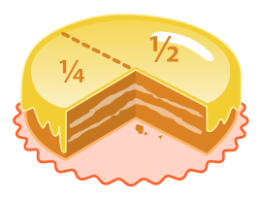

Fractions Unit
By Miss O.

Slide 2

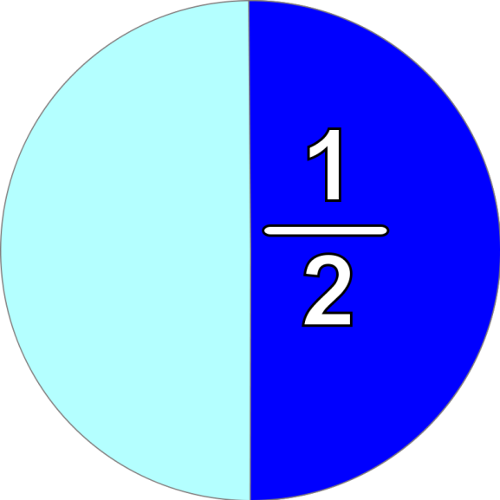
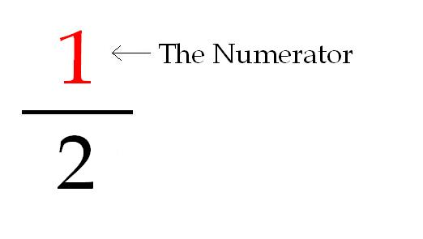
Numerator = # on top
Denominator = # on the bottom
(down below)
How many equal parts are described?
The Denominator
How many equal parts are in all (total)?
You can also write it: 1/2

Slide 3
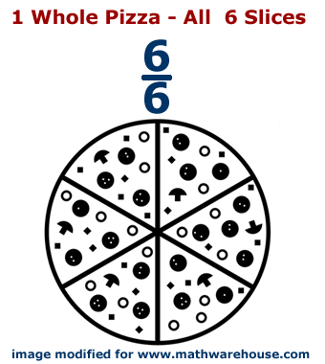
Parts of a Whole
Whole = 1 complete thing
Different from a hole in the ground

Slide 4

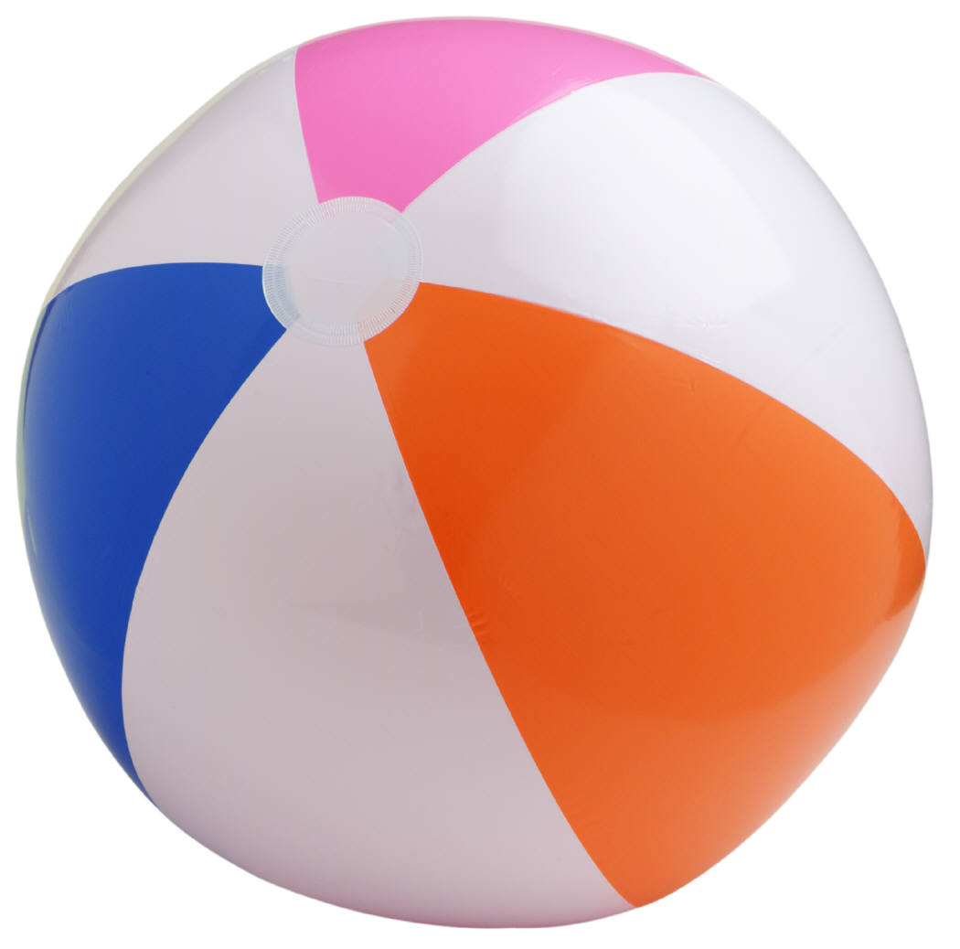
1 WHOLE → fraction
The top number and the bottom are the same!
4 5 8 55 86
4 5 8 55 86
Give me some more fractions that equal 1 whole!

Slide 5
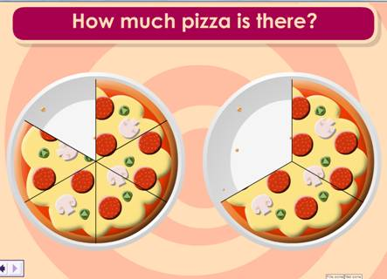
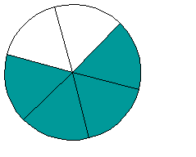
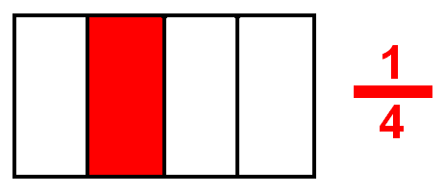
Parts of a Whole
4/6

Slide 6
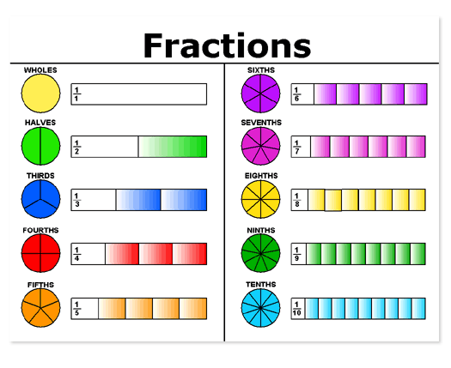

Slide 7

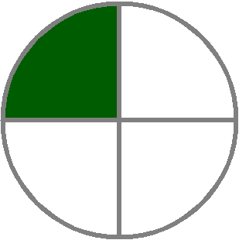
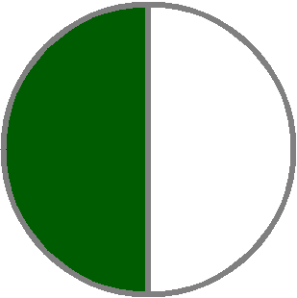

Parts of a Whole
What’s the fraction we should write for each?

Slide 8






Write a fraction for the part of each flag that is red.
Italy
Indonesia
Taiwan
Austria
Germany
Spain

Slide 9
Draw a model to show each fraction:
3 4 1
10 8 6

Slide 10
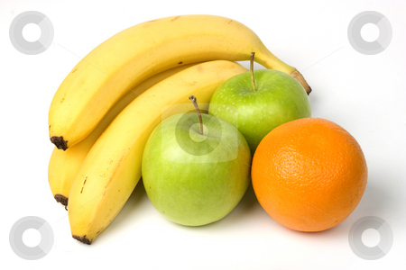
Parts of a Set
What is the total number of fruits?
  This will be your denominator!
  What fraction of this set are bananas?
  What fraction of this set are oranges?
  What fraction of this set are apples?

Slide 11
What fraction of each set is blue?
Draw a picture to show the fraction 3/5 as part of a set!

Slide 12


If 1/3 of a set is apples, what part is NOT apples?

Slide 13
Draw a model of a set to show each fraction.
2 1 5 7
3 5 6 8

Slide 14
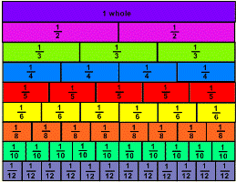
Fractions on a Number Line
Fraction Strips
How many parts?
How many parts?
How many parts?
How many parts?

Slide 15
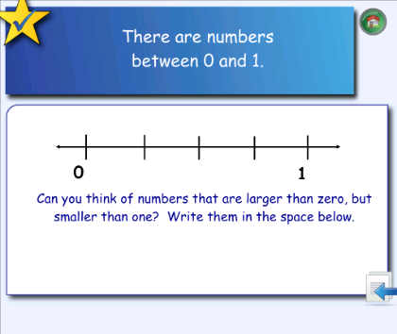
Fractions on a number line (continued)

Slide 16
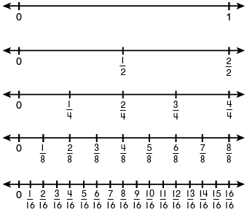
What are the fractions shaded on the number lines?

Slide 17
Fractions on Unlabeled Number Lines
Count the spaces, not the ticks!
The total number of spaces is the number that goes in the denominator!

Slide 18
Fractions on Unlabeled Number Lines
Count the spaces, not the ticks!
A
B
C
D
The total number of spaces is the number that goes in the denominator!

Slide 19

Write the missing fractions:
0
1
First, count the total number of spaces between 0 and 1 to figure out the denominator!

Slide 20
Draw your own number line and label the spaces.
0
1
Remember: count the total number of spaces between 0 and 1 to figure out the denominator!

Slide 21
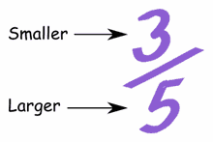
Proper Fraction
Proper fraction: fraction with a smaller number on top (numerator) than the bottom (denominator)
Talk with a partner, think up and write 2 more PROPER FRACTIONS on your worksheet packet page.

Slide 22


Math Riddle! (from Rishubh)
Using four 9’s, create the number 100. You may add, subtract, multiply, divide, or use other mathematical symbols and terms.

Slide 23
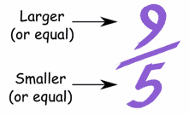
Improper Fraction
Improper Fraction: fraction with the top number (numerator) larger than the bottom number (denominator).
Talk with a partner, think up and write 2 more IMPROPER FRACTIONS on your worksheet packet page.

Slide 24
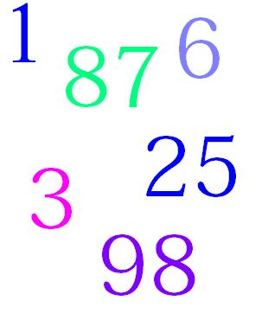
Whole Number
Whole number: regular whole numbers without fractions.
Talk with a partner, think up and write 2 more WHOLE NUMBERS on your worksheet packet page.

Slide 25
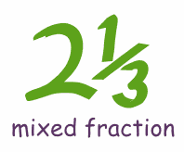
Mixed Number
Mixed Number: A whole number WITH a fraction.
Whole Number
Talk with a partner, think up and write 2 more MIXED NUMBERS on your worksheet packet page.
Fraction

Slide 26

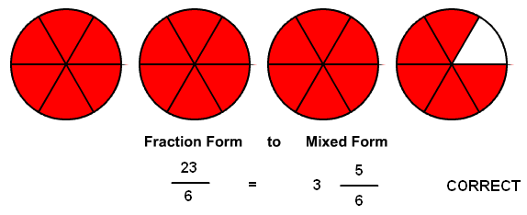
Mixed Number Models
Mixed Number = A whole + a fraction
3 wholes + 5/6 (fraction) = mixed number

Slide 27

Complete These Statements:
A mixed number is the sum of a _____________
And a ________________.
The __________________ is the number on the bottom of a fraction, and the _________________ is the number on the top of a fraction.

Slide 28
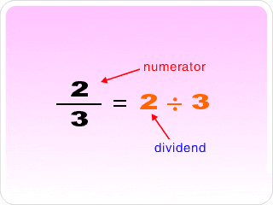

Fractions as Division Statements
Fractions are another way to write a division statement!

Slide 29
Fractions and Division are Related!
The numerator always goes inside the house!
4
5
Division
Fraction
The denominator always goes OUTSIDE the house!

Slide 30
Improper Fractions: YOU CAN DIVIDE!
And get a whole number or mixed number!
12
4

Slide 31
Proper Fractions: You CANNOT get a whole number or mixed number.
2
3

Slide 32


Change each of the fractions into division statements.
3 9 8 4 5 20
8 12 13 10 4 192

Slide 33
Write each division statement as a fraction:
(Bottom section of the worksheet page)

Slide 34
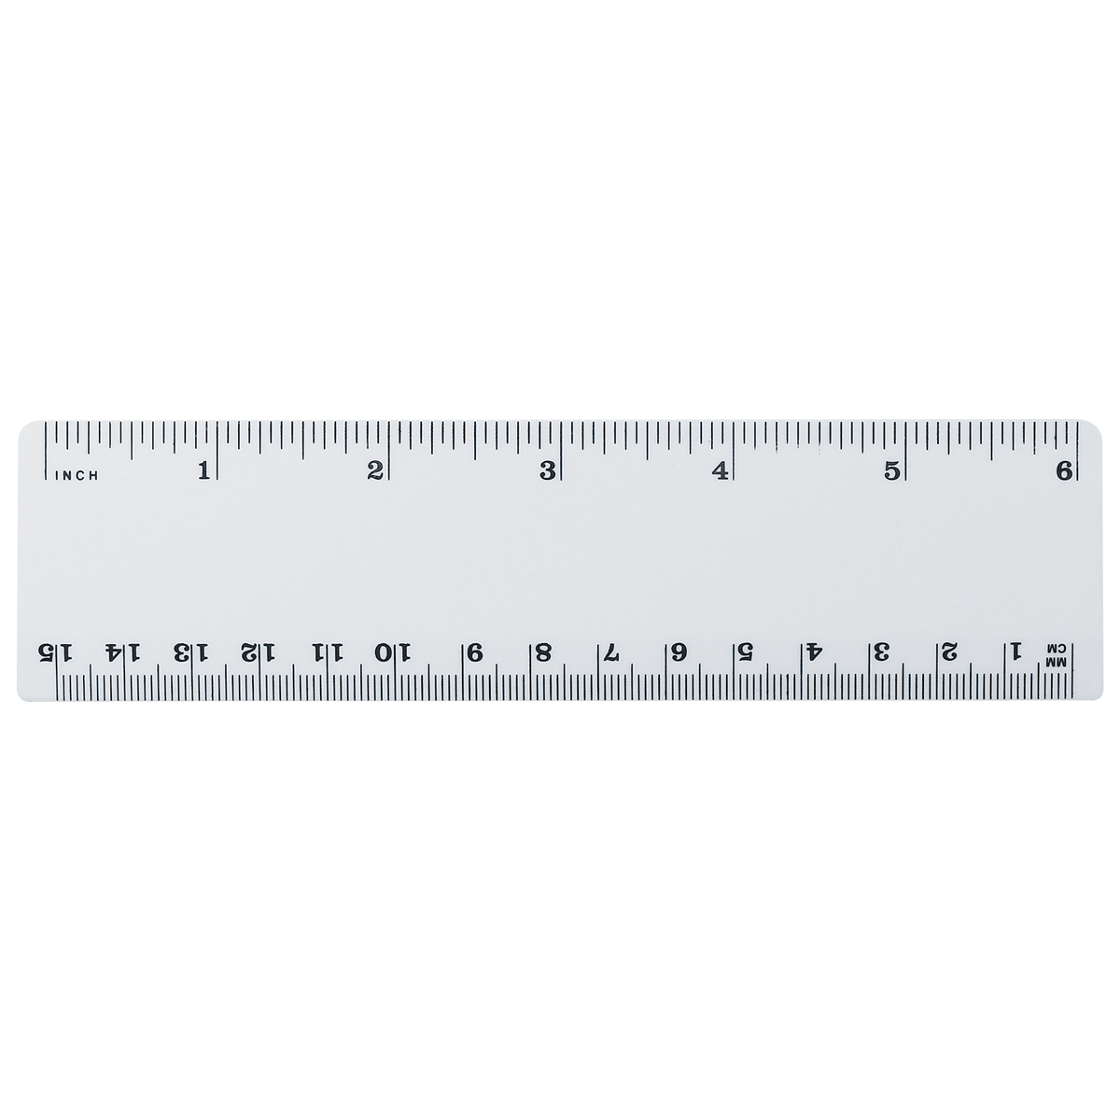
Measuring to the nearest fraction of an inch.
What is between a 1 inch and a 2 inch on a ruler?
What do all the tick marks represent?

Slide 35
The tick marks represent fractions!
Fractions are between each inch on a ruler.
Using fractions of an inch makes your measuring more EXACT.

Slide 36
“Benchmark” Fractions You Have to MEMORIZE!
1
8
3
8
5
8
7
8
1
4
3
4
1
2
0
1
How long is the length of the arrow to the nearest inch?
Benchmark means “standard.”

Slide 37
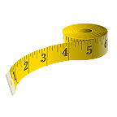
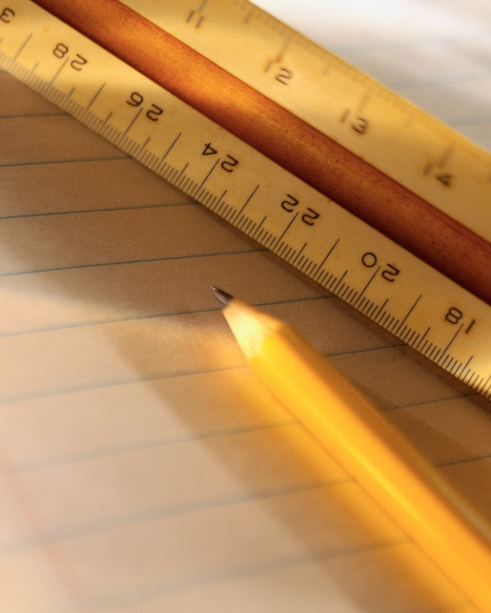
Fractions of an Inch Song
(to the tune of “Here We Go Round the Mulberry Bush”)
Tap your tip on a half of an inch,
Half of an inch, half of an inch.
Tap your tip on a half of an inch;
There’s 2 in every inch!
2
2
0
1
2
1 =

Slide 38
Fractions of an Inch Song Verse 2
Tap your tip on a quarter of an inch,
Quarter of an inch, quarter of an inch.
Tap your tip on a quarter of an inch;
There’s 4 in every inch!
1 = 2
2 4
4
4
0
1
4
2
4
3
4
1 =

Slide 39
Fractions of an Inch Song Verse 3
Tap your tip on a eighth of an inch,
Eighth of an inch, eighth of an inch.
Tap your tip on a eighth of an inch;
There’s 8 in every inch!
1 = 4
2 8
8
8
1
8
3
8
5
8
7
8
0
2
8
4
8
6
8
1 =

Slide 40
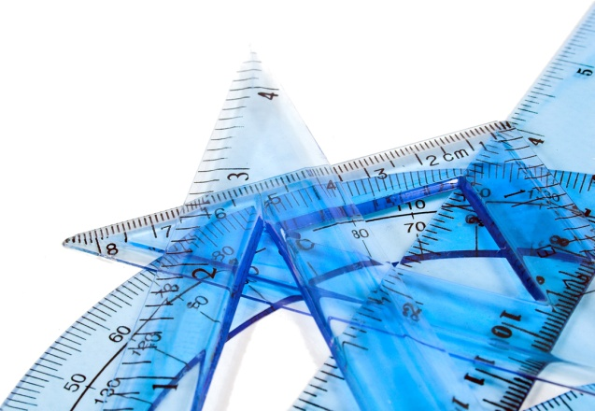
A Poem to Help Us Memorize
1
8
3
8
5
8
7
8
1
4
3
4
1
2
0
1
Start with one eighth, then one fourth,
Next three-eighths, and half of course!
After that comes five-eighths,
Three-fourths, seven-eighths—wow, we’re great!

Slide 41
Finding Fractions of An Inch Worksheet
Trace each inch mark in yellow.
Trace each half-inch (1/2) mark in orange.
Trace each quarter-inch (1/4) mark in red.
Trace each eighth-inch (1/8) mark in blue.
Trace each sixteenth-inch (1/16) mark in green.

Slide 42
What if the marks are NOT labeled?
Like on MOST rulers…
That’s why you have them MEMORIZED…
  So…you can write them in yourself and still be able to measure to a fraction of an inch!

Slide 43
Let’s practice!
0
1
How long is the length of the arrow to the nearest fraction of an inch?
inches
Share your answer with a partner!

Slide 44

Let’s keep practicing!
0
1
How long is the length of the arrow to the nearest fraction of an inch?
inches
Write your answer in your math notebook.

Slide 45
And some more!
0
1
How long is the length of the arrow to the nearest fraction of an inch?
inches
Write your answer in your math notebook.

Slide 46
Estimating Fractional Parts
Estimating means “guesstimating.”
1
8
3
8
5
8
7
8
1
4
3
4
1
2
0
1
Using the “benchmark fractions” we have been learning with measuring the nearest inch, we can “guesstimate” fractional parts too!

Slide 47

“About” how much is shaded?

Slide 48
“About” where is each point?
A
B
C
D
0
1

Slide 49

1 Whole in fraction form
Which one is NOT a whole number fraction?
10
10
1
1
8
8
1
5
5
5
73
73
9
9
Same digit on the top and same digit on the bottom!
6
6
44
44
102
102

Slide 50
Multiply a fraction by 1 = _______
THE SAME NUMBER!!!!
3
4
1
3
4
So…
3
4
4
4

Slide 51
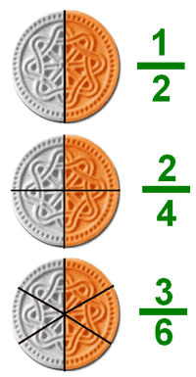

Equivalent Fractions
Fractions that are EQUAL to one another but “look” differently.
2
4
1
2
=

Slide 52
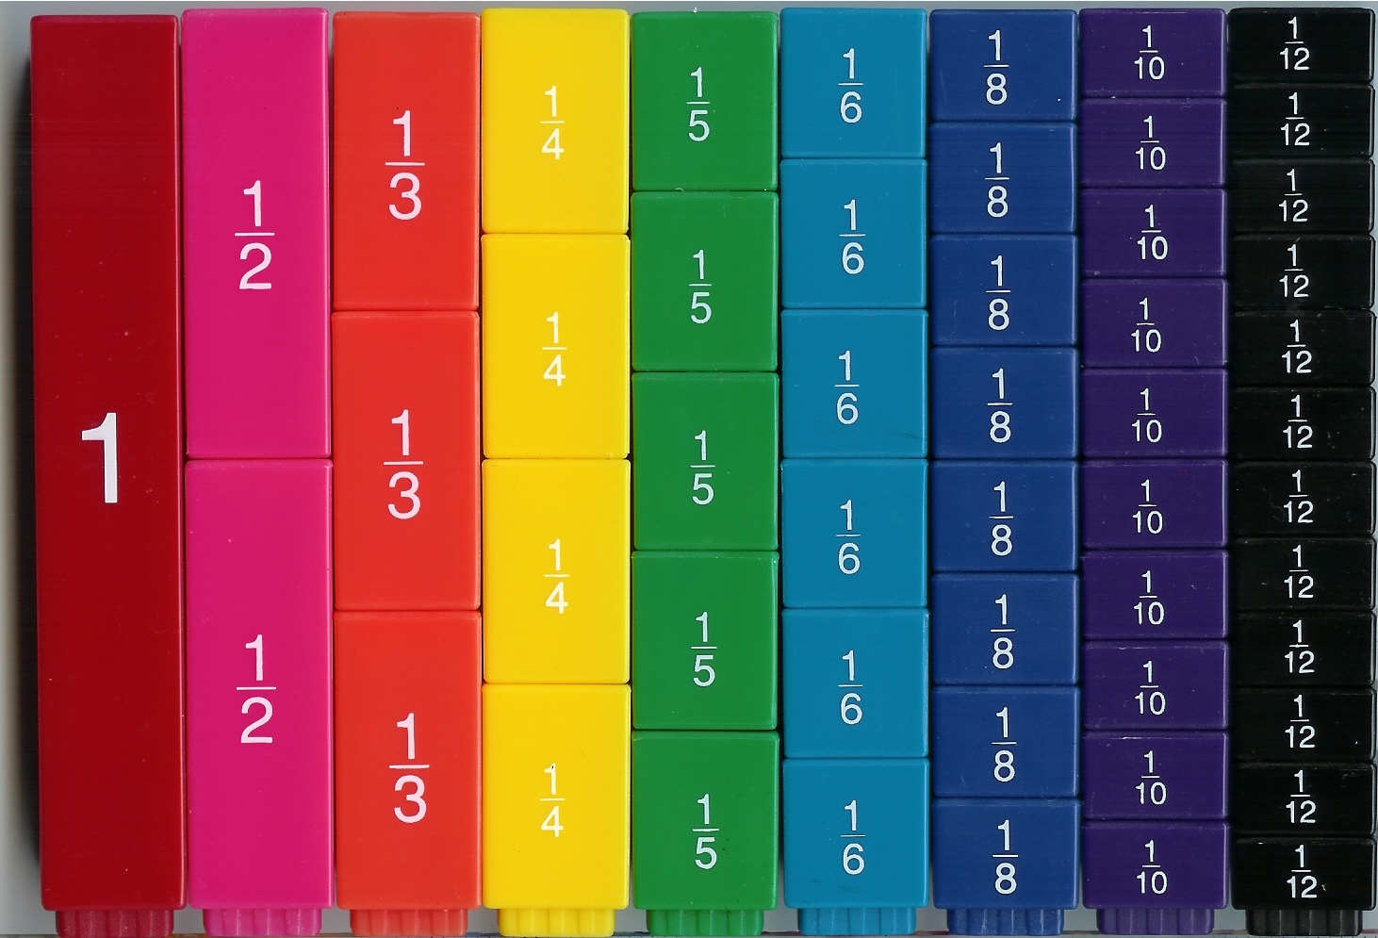
Fraction Bar Exploration!
Equivalent Fractions are the same amount!
Talk and turn with your partner to identify 3 sets of fractions that are the same amount!

Slide 53

How can you find equivalent fractions without fraction bars?
Remember: Any number multiplied or divided by 1 is always itself!
2
5
1
2
5
2
5
2
5
1
Brought to you by…the IDENTITIY PROPERTY!

Slide 54
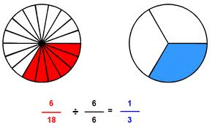
What kind of fraction can represent 1?
5 OR 6 OR 8
5 6 8
So, here we divide 6/18 by 6/6 (which is really 1 whole to get it’s equivalent fraction relative!

Slide 55
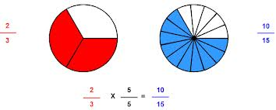
Multiply to get a more “complicated” fraction!

Slide 56
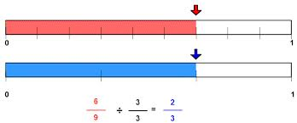
Divide to get a more “simple” fraction!

Slide 57

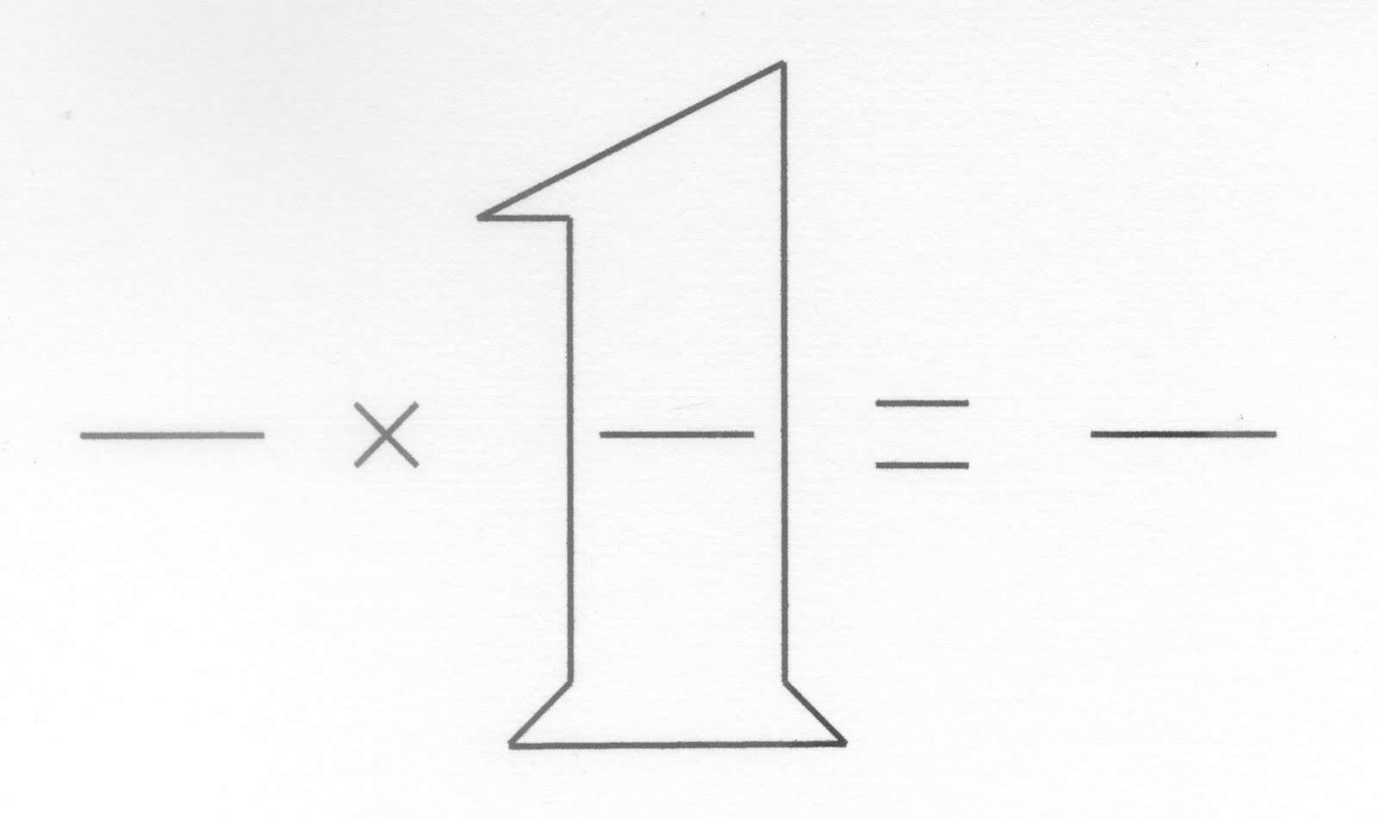
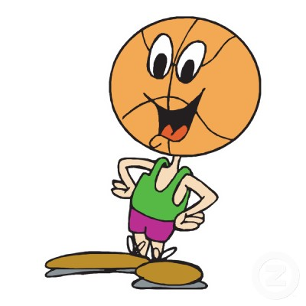
Find an equivalent fraction for 2/5!
*Multiply it by any fraction that is equal to 1 whole!
2
5
Because you are multiplying will you get a more complicated or more simple equivalent fraction?

Slide 58

Find an equivalent fraction for 4/6!
*Divide it by any fraction that is equal to 1 whole!
4
6
Because you are dividing will you get a more complicated or more simple equivalent fraction?

Slide 59

Take a Quick Break!

Slide 60
Let’s do one with a friend!
1
2

Slide 61
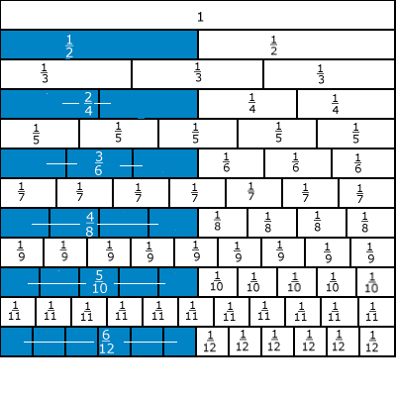
Look at how ½ has MANY Equivalents!

Slide 62
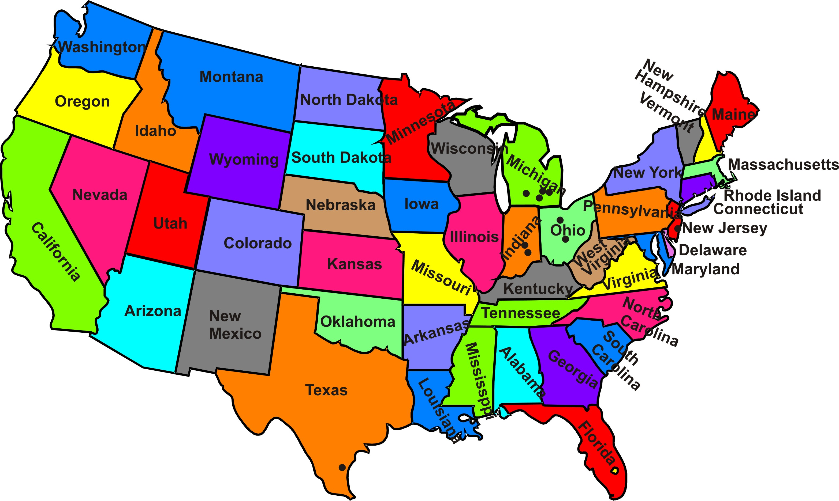

Equivalent Fractions with a map!
Write two equivalent fractions to describe the part of the states along the Atlantic Ocean that have a name starting with M.

Slide 63
Equivalent Fractions with a map!
Write two equivalent fractions to describe the part of the states along the Atlantic Ocean that have a name starting with N or R.

Slide 64
Equivalent Fractions with a map!
Write two equivalent fractions to describe the part of the states along the Atlantic Ocean that are north of Virginia.

Slide 65
Equivalent Fractions with a map!
Write two equivalent fractions to describe the part of the states along the Atlantic Ocean that have a direction in their name.

Slide 66
Equivalent Fractions with a map!
Write two equivalent fractions to describe the part of the states along the Atlantic Ocean that have a name ending in a vowel.

Slide 67
Equivalent Fractions with a map!
Write two equivalent fractions to describe the part of the states along the Atlantic Ocean that have a two-word name.

